Slide 1

Evaluation of Various Sensing Modalities for Accurate Measurement of Neck Flexion Angle during Thyroid and Ear Surgery
Final Presentation
Team Member : Zhen Hu, Hanqing Duan
Mentor: Dr. Russell Taylor, Dr. Deepa Galaiya

Slide 2
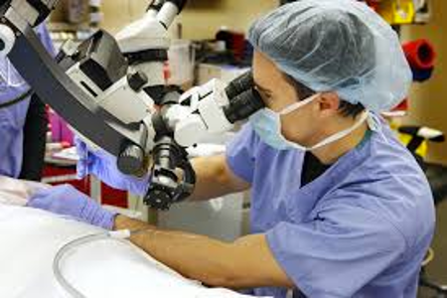
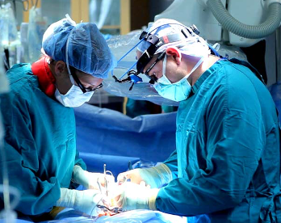
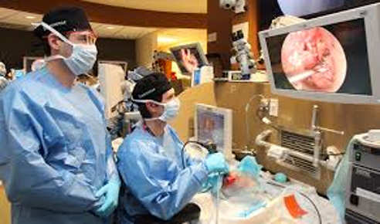
Background
Ear Surgery & Thyroid Surgery
Traditional case: looking through microscopes & standing over patient
Endoscopic case: looking at a monitor
Pictures from：https://oklahoman.com/gallery/articleid/3808606/
http://amandeepmedicity.org/specialities/bariatric-metabolic-surgery
http://www.tristonekidneyhospital.com/index.html
Notes:
介绍两种手术
医生站立时间过久
所以重要

Slide 3
Significance
Poor surgical ergonomics may lead surgeon disability
–2/3 of surgeons reported neck discomfort related to their occupation[1]
–Prevalence of musculoskeletal symptoms in the neck and shoulders is as high as 87% [2]
Dangers of Forward Head Posture (FHP) can be described as a “DOMINO EFFECT” [3]:
Head moves forward → shifting the center of gravity → upper body drifts backward → hips tilt forward
Hence, FHP can not only cause neck pain but can also be a root cause of mid/lower back pain.
1.Khansa I, Khansa L, Westvik TS, Ahmad J, Lista F, Janis JE. Work‐related musculoskeletal injuries in plastic surgeons in the United States, Canada, and Norway. Plast Reconstr Surg. 2018;141(1):165e‐175e.
2.Capone AC, Parikh PM, Gatti ME, Davidson BJ, Davison SP. Occupational injury in plastic surgeons. Plast Reconstr Surg. 2010;125(5):1555‐1561.
3. Naresh-Babu, J et al. “Surgeon's Neck Posture during Spine Surgeries: “The Unrecognised Potential Occupational Hazard”.” Indian journal of orthopaedics vol. 53,6 (2019): 758-762. doi:10.4103/ortho.IJOrtho_677_18
Notes:
Show advantages of endoscopic surgery
Use these data to correct surgeons’ posture

Slide 4
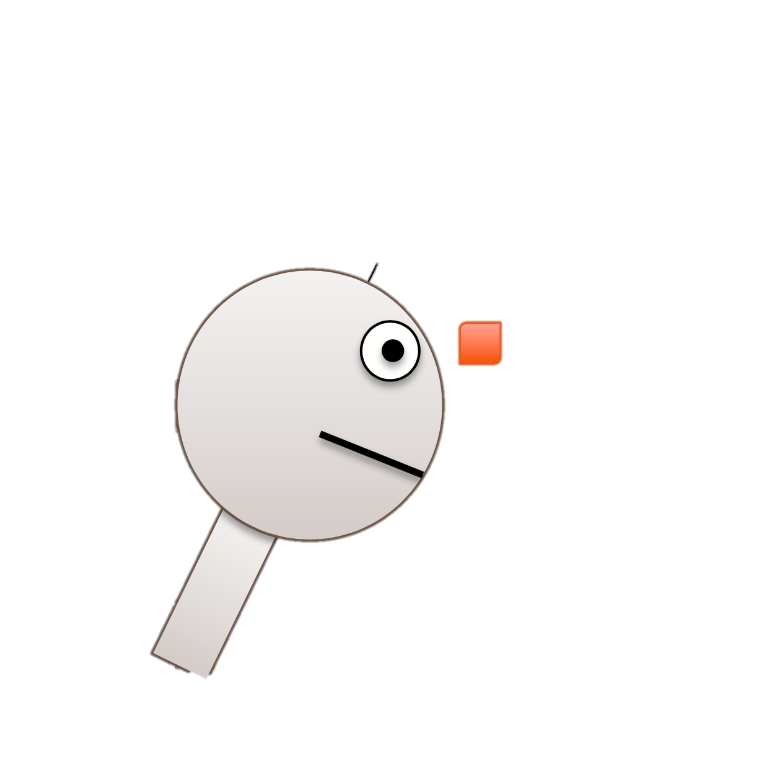
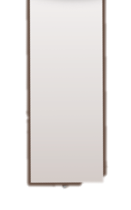


Project Goal
A6
Goal: Accurate Measurement of Neck Flexion Angle during Thyroid and Ear Surgery by using IMUs
IMU: Inertial measurement unit
Accurate: Calibrate IMUs’ pitch angle against EM tracker
Neck Flexion Angle: extract pitch angle between two IMUs
Surgeries: Analyze neck flexion angle changes in different scenarios.
$$θ$$
1A
Figure Edit from: https://stanford.edu/class/ee267/lectures/lecture10.pdf
Notes:
To investigate and compare postural ergonomics of surgeons during two different surgical scenarios

Slide 5
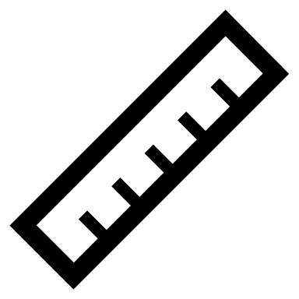






Technical Approach
Calibrate IMUs
with EM trackers
Collect Data
from Mock Surgery
Analyze Angles
and Changes
Write
Report
Setup Software
Environment
Derive Physical
Models

Slide 6
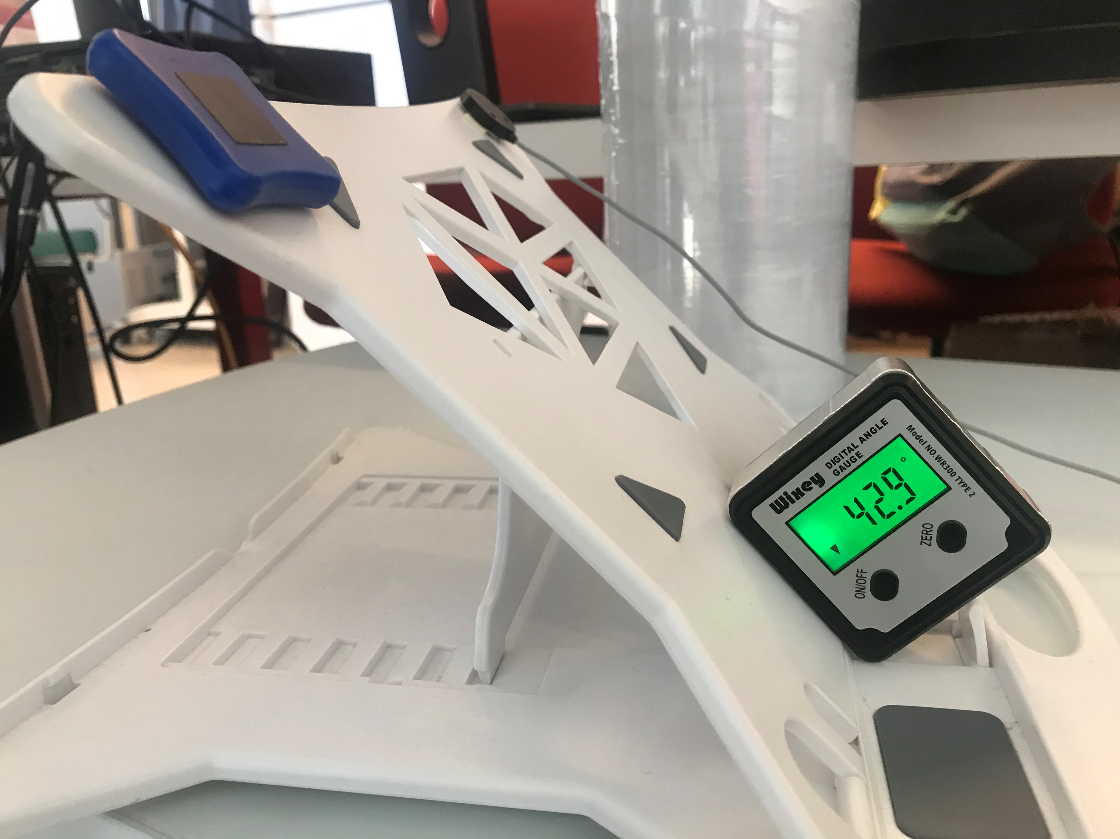
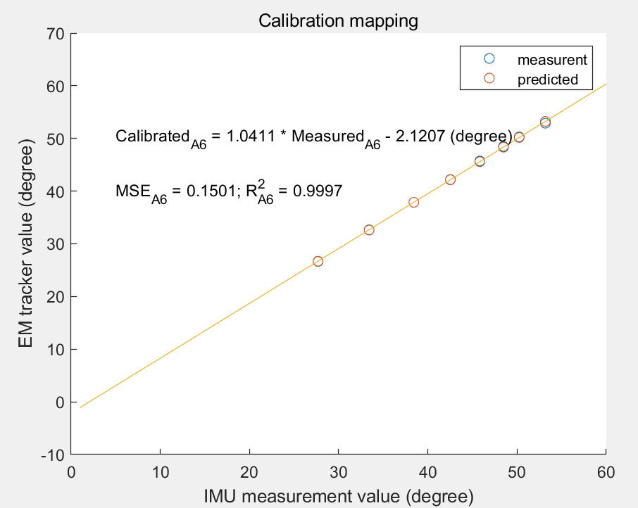
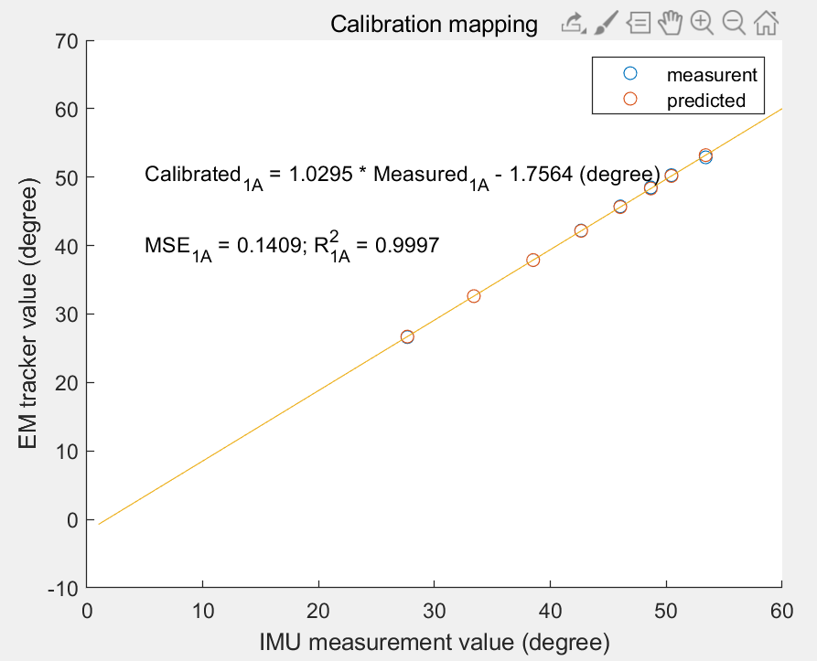
Calibration Result
EM tracker
IMU
One IMU vs one EM tracker – ground truth
Calculate flexion angle mathematically by using data from IMU and EM tracker
Do linear regression for both IMU A6 and 1A with EM tracker using samples data
Laptop Stand

Slide 7
Neck Flexion Angle Model
At the beginning, surgeon stands and stays unmoved: reference position
While surgeon operating: other positions
Get Euler Angle from IMUs
Calibrate Euler Angle
Euler Angle to Rotation Matrix R
Derive Pitch Angle
Derive Rd required to go from 1A to A6
Derive R’ w.r.t. Reference

Slide 8
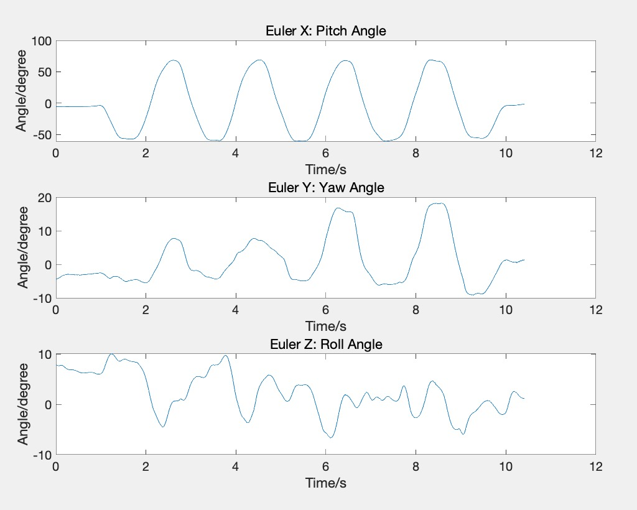
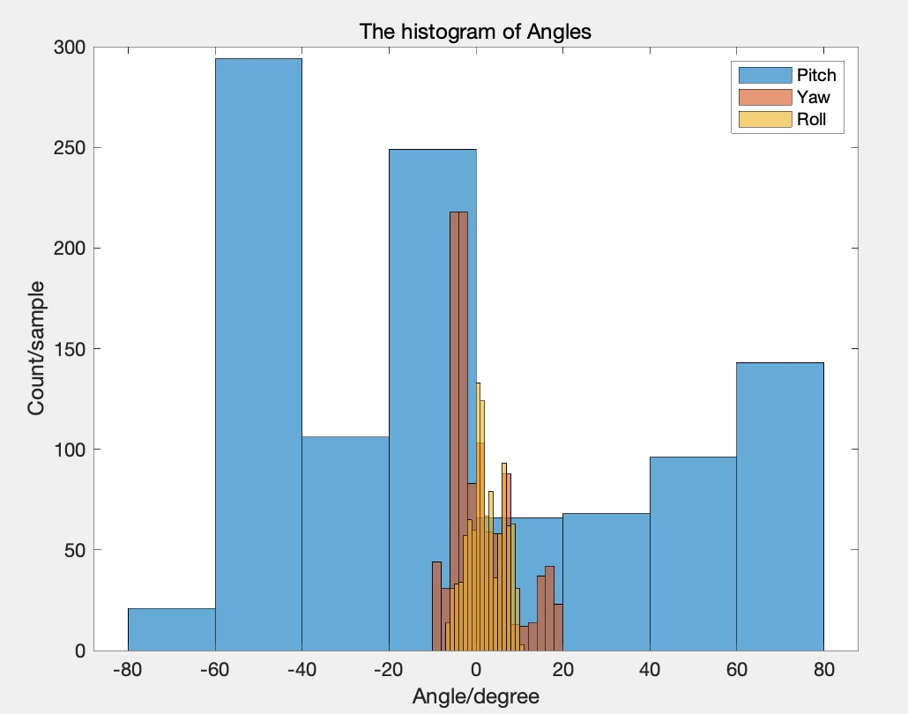
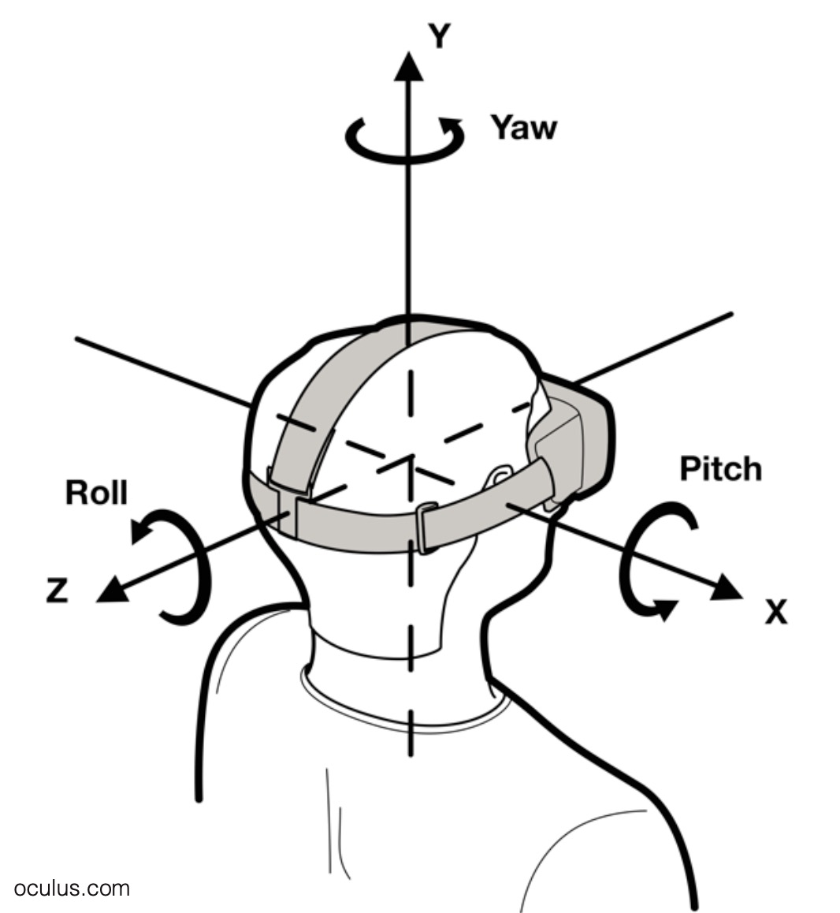
Mock OR Data Analysis – turn up and down
Pitch angle changes between -80° to 80° strongly and periodically.
Yaw angle and Roll angle changes little.
Coordinate system figure from: https://stanford.edu/class/ee267/lectures/lecture10.pdf

Slide 9
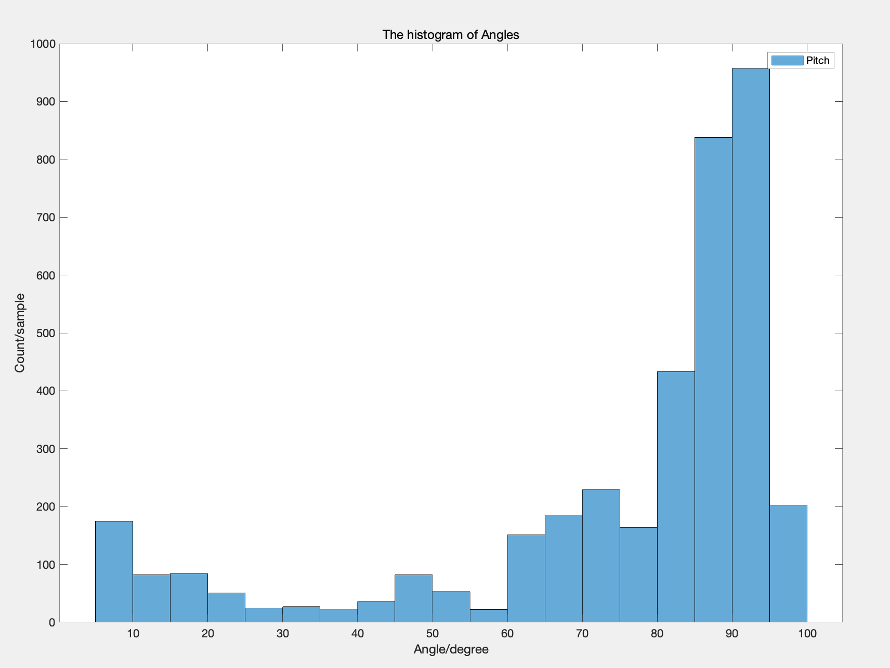
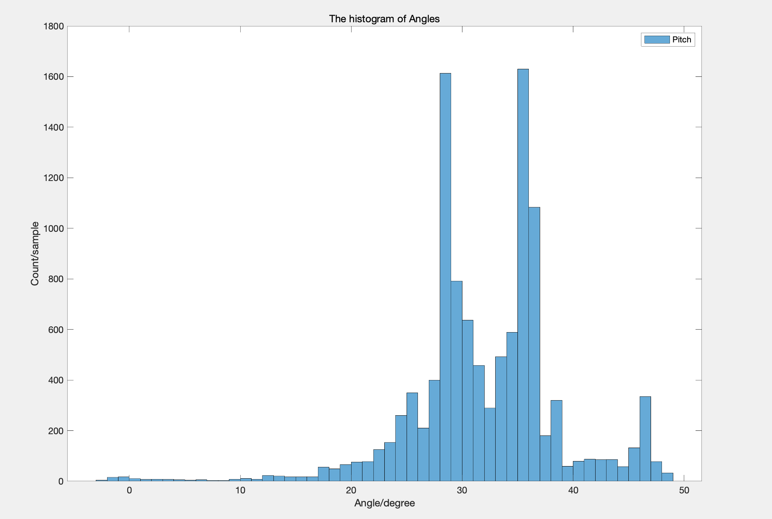
Mock OR Data Analysis
Traditional case
Endoscopic case
Neck flexion angle keeps at 75° to 100°
for a long time;
Mean: 74.9309 ° SD: 25.1643°
Neck flexion angle keeps at 25° to 35°
for a long time;
Mean = 32.1144° SD: 6.6778°
Permutation test: p = 6.6805e-05

Slide 10
Mock OR Data Analysis - Conclusion
In a series by Lee, muscle fatigue levels of the right and left upper trapezius was highest when neck flexion angle is at 50° and lowest at 30°. [1]
In traditional case, neck flexion angle was above 50° for a long time, proving that muscle fatigue levels of trapezius is highest. Compared with endoscopic case, all the neck flexion angle was below 50°, proving that the risk of back pain is lower.
Conclusion: the usage of endoscope was found to be beneficial by avoiding the abnormal neck posture angles when compared to the traditional surgery case.
[1] Lee S, Lee D, Park J. Effect of the cervical flexion angle during smart phone use on muscle fatigue of the cervical erector spinae and upper trapezius. J Phys Ther Sci 2015;27:1847-9.

Slide 11
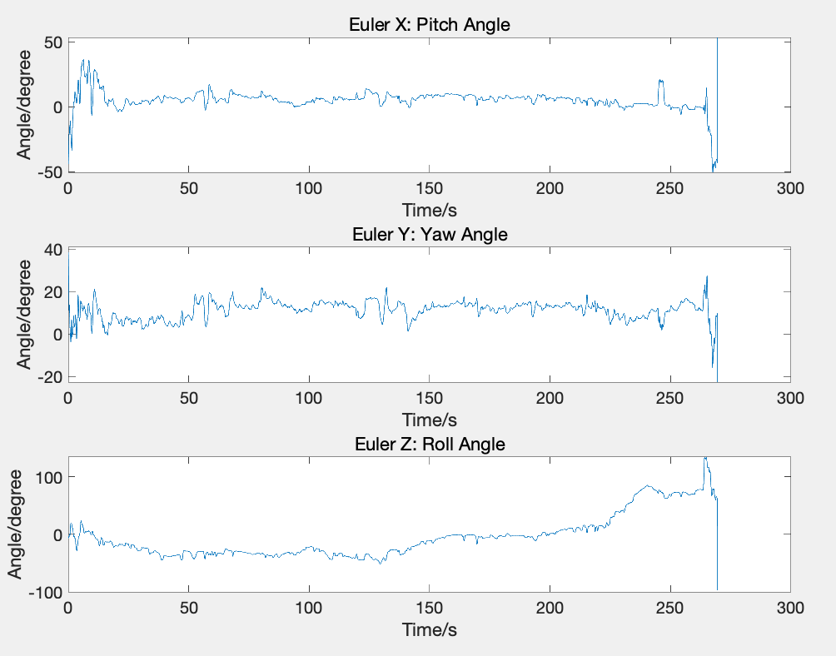
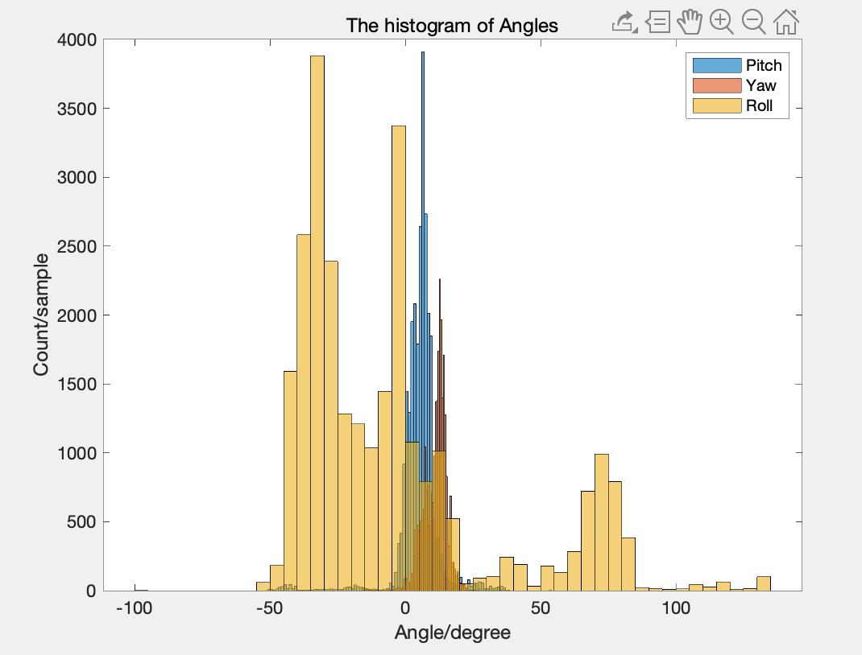
Ergonomics Position Data Analysis
Sitting at soft desk chair, typing
Pitch angle concentrates on 0°
Yaw angle concentrates on 10°.
Roll angle changes in a large range.
Coordinate system figure from: https://stanford.edu/class/ee267/lectures/lecture10.pdf

Slide 12
Deliverables
Minimum:
Calibration result of two IMUs separately against EM tracker
Documentation of software setting and calibration steps
Expected:
Data analysis report of mock OR surgery data
Maximum:
Data analysis report of all possible scenarios.
Final report

Slide 13
Future Work
Get Real Clinical Data, then:
Data analysis and comparison of different surgery scenarios
Clinical paper
Wearable Warning System Design

Slide 14
Management
Hanqing: IMU Calibration, Documentation of Environment setup, Documentation of Calibration.
Zhen: Neck flexion angle derivation, Documentation of Angle derivation, Documentation of Code.
Hanqing and Zhen: Project proposal, Mock OR Data Analysis, Ergonomics data Analysis, Final report.

Slide 15
What we have learnt
Time management
Emergency plan
Elevator pitch
How to overcome difficulties

Slide 16
Reference
Yan, Xuzhong, et al. “Wearable IMU-based real-time motion warning system for construction workers' musculoskeletal disorders prevention.” Automation in Construction 74 (2017): 2-11.
Versteyhe, Mark, et al. “A Novel Method to Estimate the Full Knee Joint Kinematics Using Low Cost IMU Sensors for Easy to Implement Low Cost Diagnostics.” Sensors 20.6 (2020): 1683.
A tutorial on Euler angles and Quaternions – http://www.weizmann.ac.il/sci-tea/benari/
Naresh-Babu, J et al. “Surgeon's Neck Posture during Spine Surgeries: “The Unrecognised Potential Occupational Hazard”.” Indian journal of orthopaedics vol. 53,6 (2019): 758-762. doi:10.4103/ortho.IJOrtho_677_18
Lobo D, Anuarbe P, López-Higuera JM, Viera J, Castillo N, Megía R. Estimation of surgeons' ergonomic dynamics with a structured light system during endoscopic surgery. Int Forum Allergy Rhinol. 2019;9(8):857–864. doi:10.1002/alr.22353
Lee S, Lee D, Park J. Effect of the cervical flexion angle during smart phone use on muscle fatigue of the cervical erector spinae and upper trapezius. J Phys Ther Sci 2015;27:1847-9.

Slide 17
Thanks!

Slide 18
Calibration Method – Set up
One IMU vs one EM tracker – ground truth
Stick IMUs and EM tracker at the same plane
Use the laptop stand to change angles
Collect Quaternion data for two IMUs and EM trackers with 9 different angles for a while by using rosbag in Linux
One for reference (horizontal plane)
Eight for different pitch angle samples
Last a while for averaging to remove noise
EM tracker
IMU
Laptop Stand
Notes:
IMU and EM tracker cannot be banded together because of magnetic field
Stable for a while at 9 different angles
Collect data at the same time

Slide 19
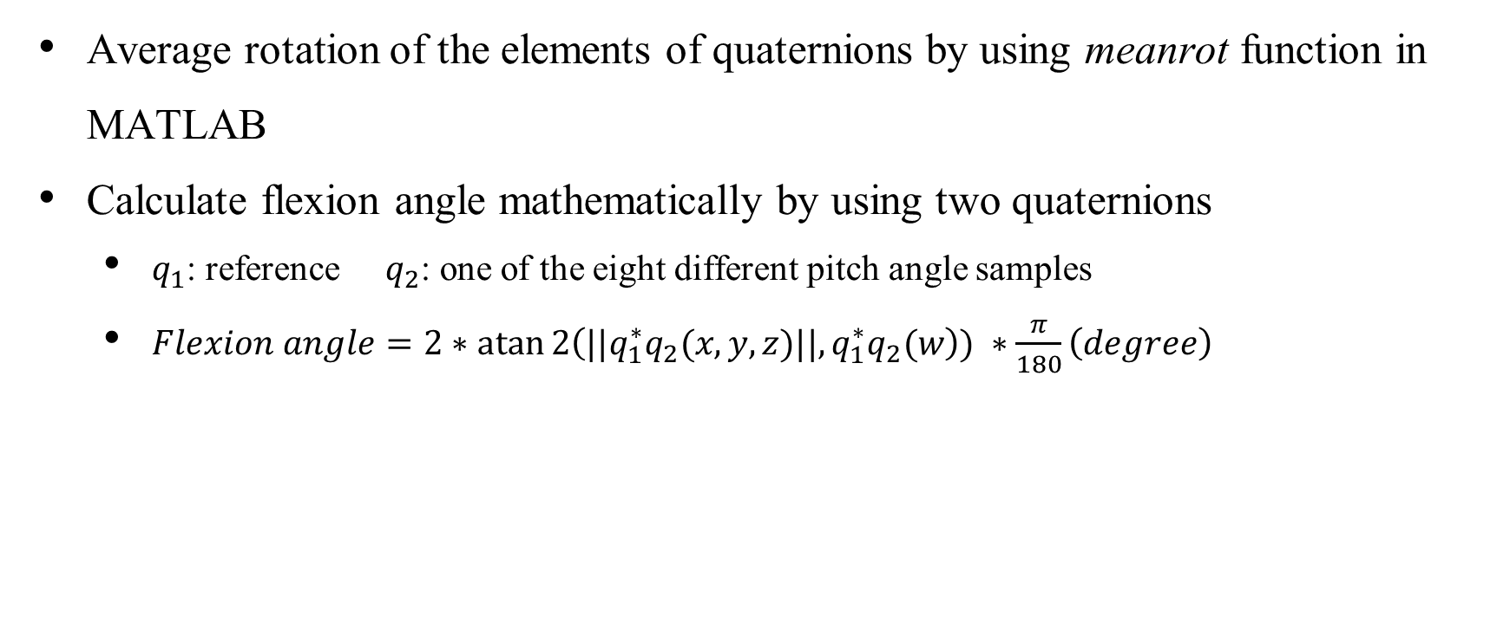
Calibration Method – Pitch angle calculation
Average rotation of the elements of quaternions by using meanrot function in MATLAB
Calculate flexion angle mathematically by using two quaternions
$q_{1}$: reference $q_{2}$: one of the eight different pitch angle samples
$Flexion angle=2∗\operatorname{atan}{2\left({||q}_{1}^{∗}q_{2}(x,y,z)||,q_{1}^{∗}q_{2}(w\right))} ∗\frac{π}{180}\left(degree\right)$
Flexion angle from EM tracker (degree) | Flexion angle from IMU 1A (degree) | Flexion angle from IMU A6 (degree)
26.6346 | 27.6527 | 27.6778
32.6116 | 33.3907 | 33.4102
37.8730 | 38.5087 | 38.4184
42.1996 | 42.6490 | 42.52
45.7238 | 46.0262 | 45.8209
48.4941 | 48.6611 | 48.4686
50.2905 | 50.4428 | 50.2339
52.8936 | 53.3970 | 53.1683

Slide 22
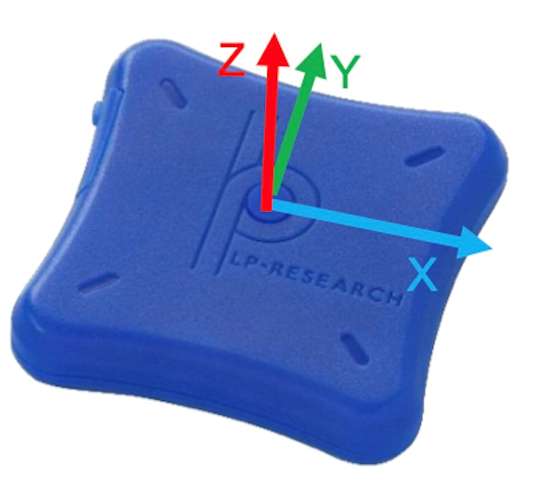
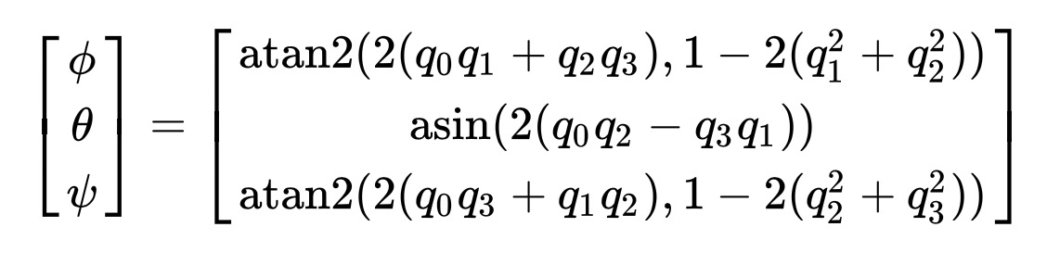
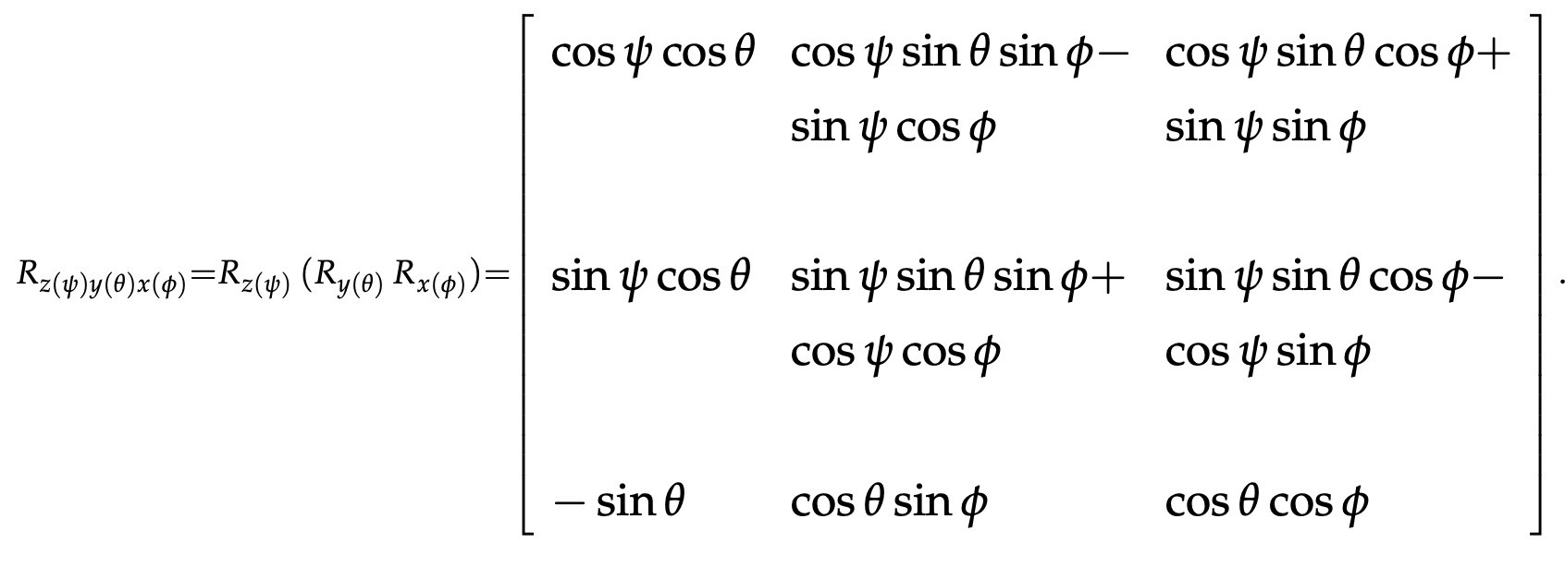
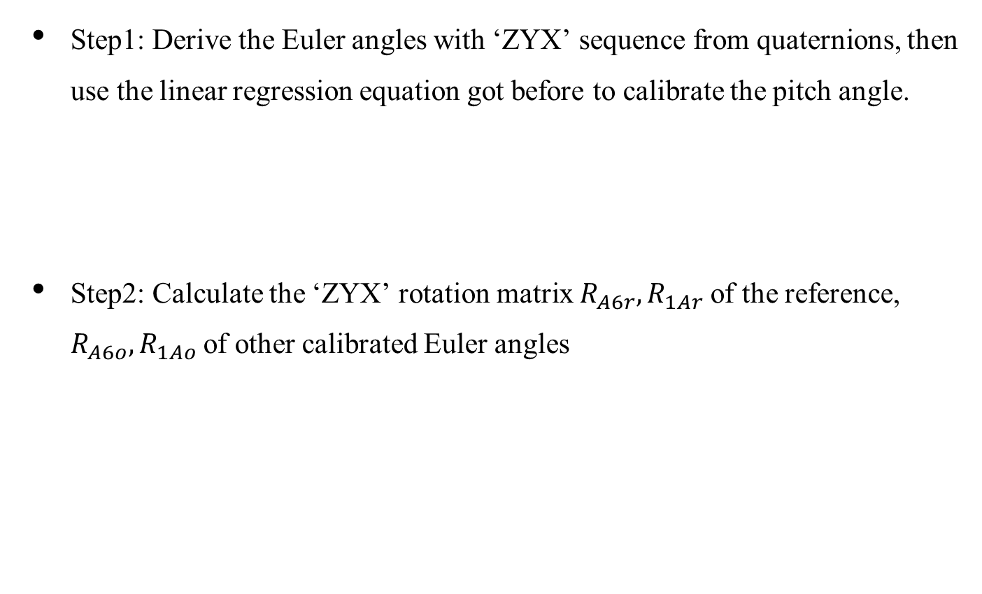
Neck Flexion Angle Model
Upper Figure from: LPMS-B2 Series Hardware Manual ver 1.0
Step1: Derive the Euler angles with ‘ZYX’ sequence from quaternions, then use the linear regression equation got before to calibrate the pitch angle.
Step2: Calculate the ‘ZYX’ rotation matrix $R_{A6r}, R_{1Ar}$of the reference, $R_{A6o}, R_{1Ao}$of other calibrated Euler angles
—
= -
+
—
Lower Figure from: https://stanford.edu/class/ee267/lectures/lecture10.pdf

Slide 23
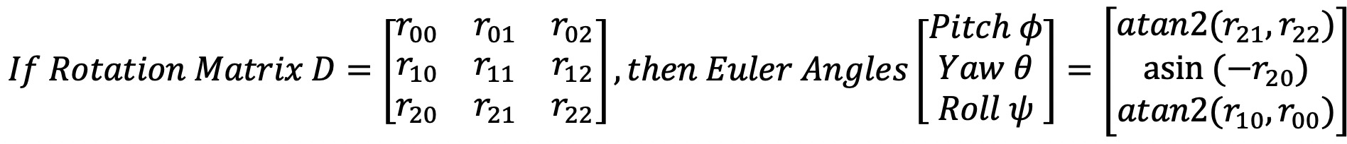
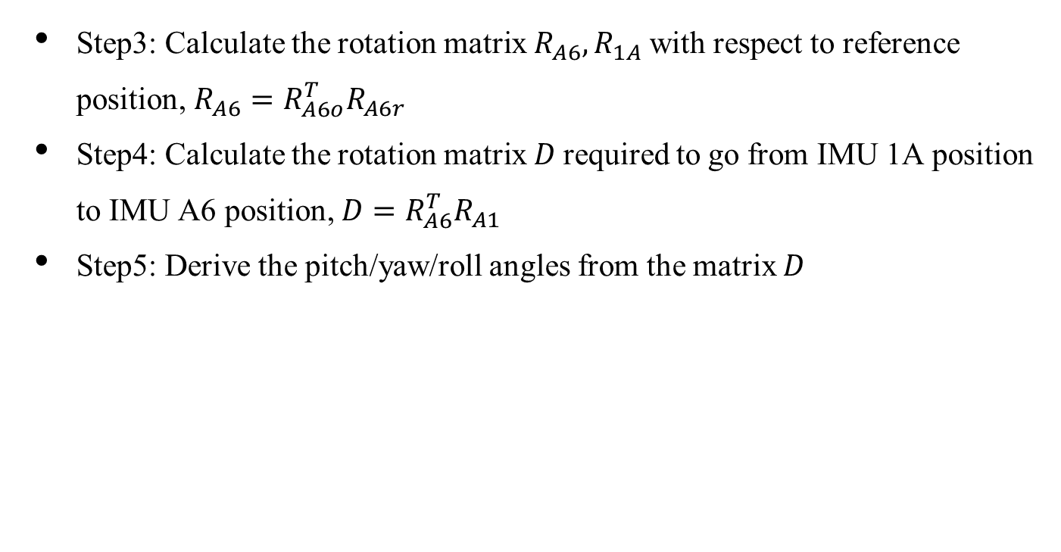
Neck Flexion Angle Model
Upper Figure from: LPMS-B2 Series Hardware Manual ver 1.0
Step3: Calculate the rotation matrix $R_{A6}, R_{1A}$with respect to reference position, $R_{A6}=R_{A6o}^{T}R_{A6r}$
Step4: Calculate the rotation matrix $D$required to go from IMU 1A position to IMU A6 position, $D=R_{A6}^{T}R_{A1}$
Step5: Derive the pitch/yaw/roll angles from the matrix $D$
Lower Figure from: https://stanford.edu/class/ee267/lectures/lecture10.pdf

Slide 24
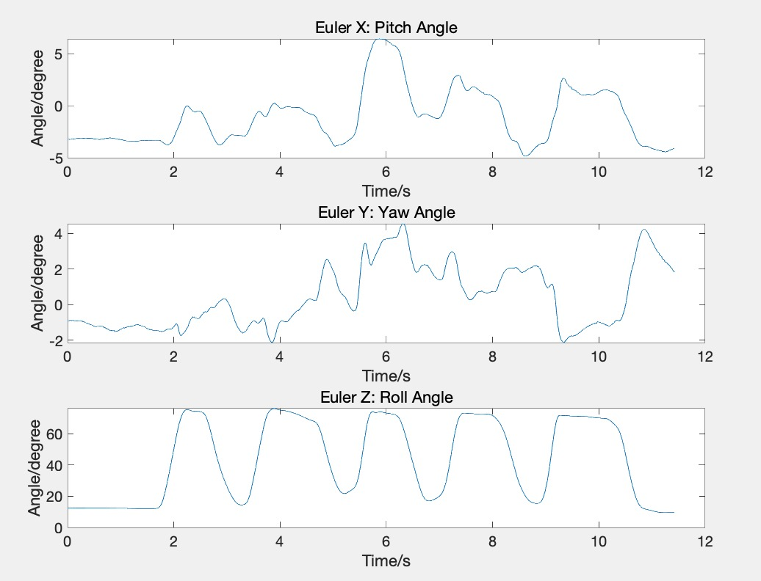
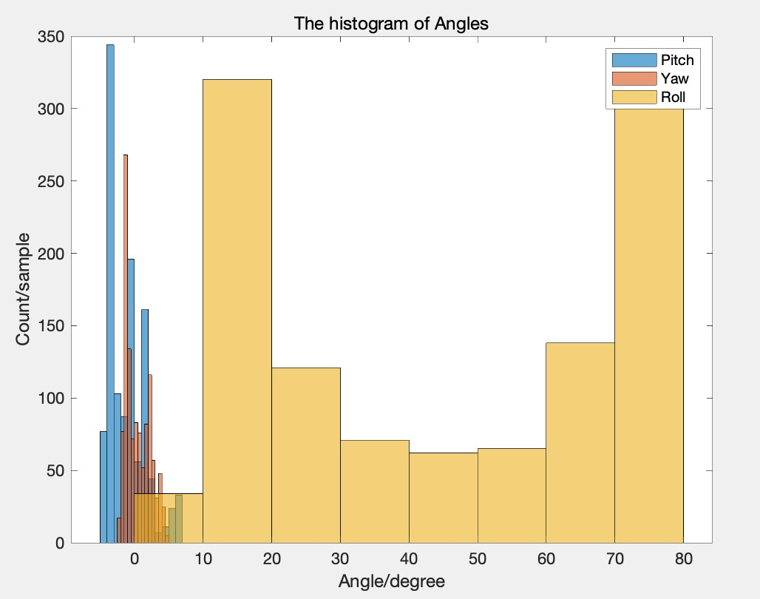
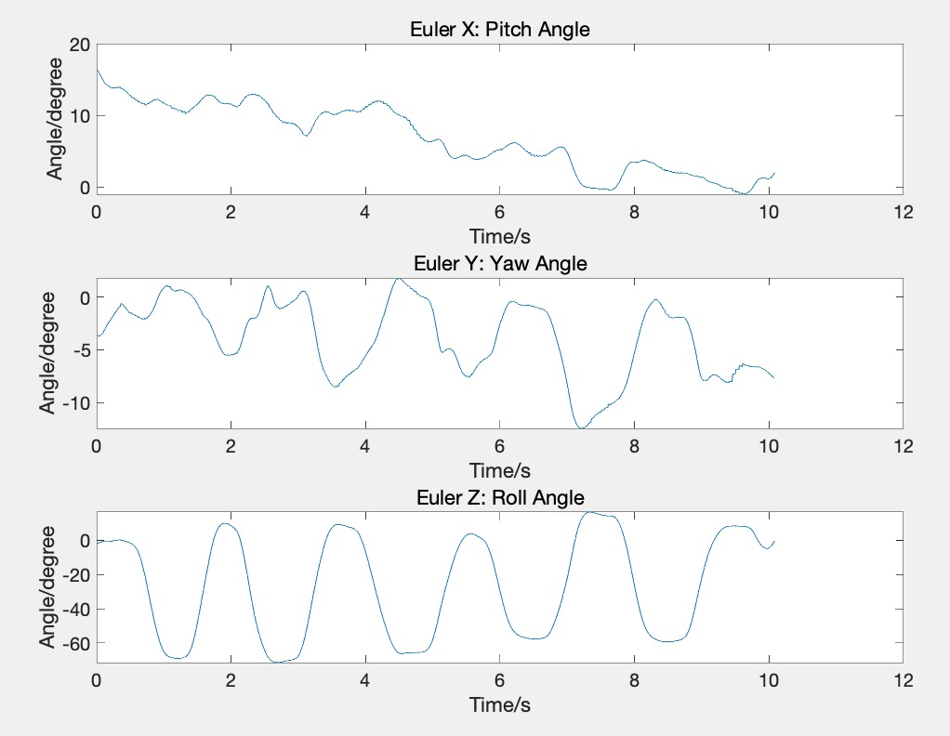
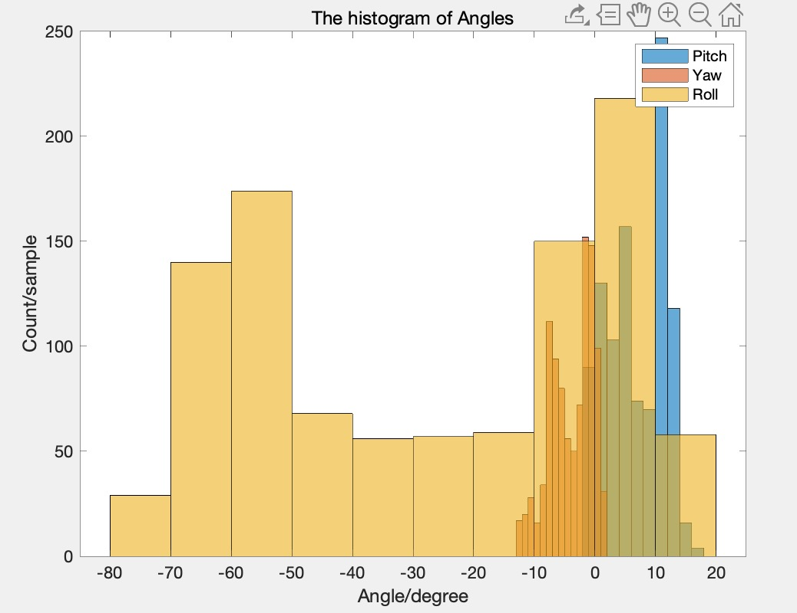
Mock OR Data Analysis – rotate to left & right
Rotate to left
Roll angle changes between 0 degree to 80 degree periodically.
Rotate to
right
Roll angle changes between -80 degree to 20 degree periodically.
Pitch angle and Yaw angle change little and there is no significant difference between left and right circumstances.
Coordinate system figure from: https://stanford.edu/class/ee267/lectures/lecture10.pdf

Slide 25
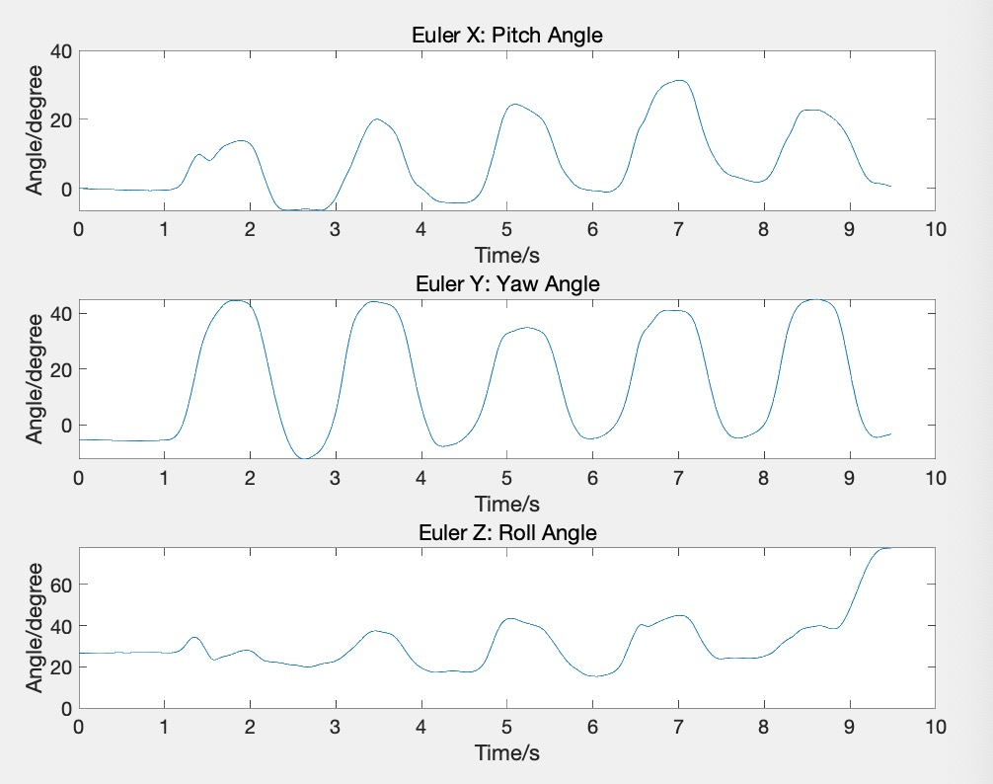
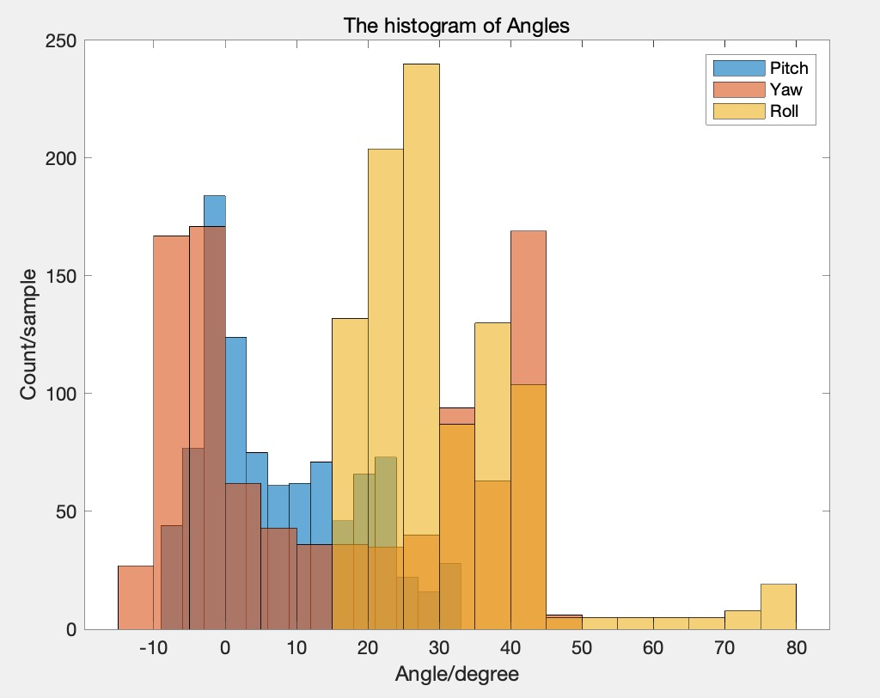
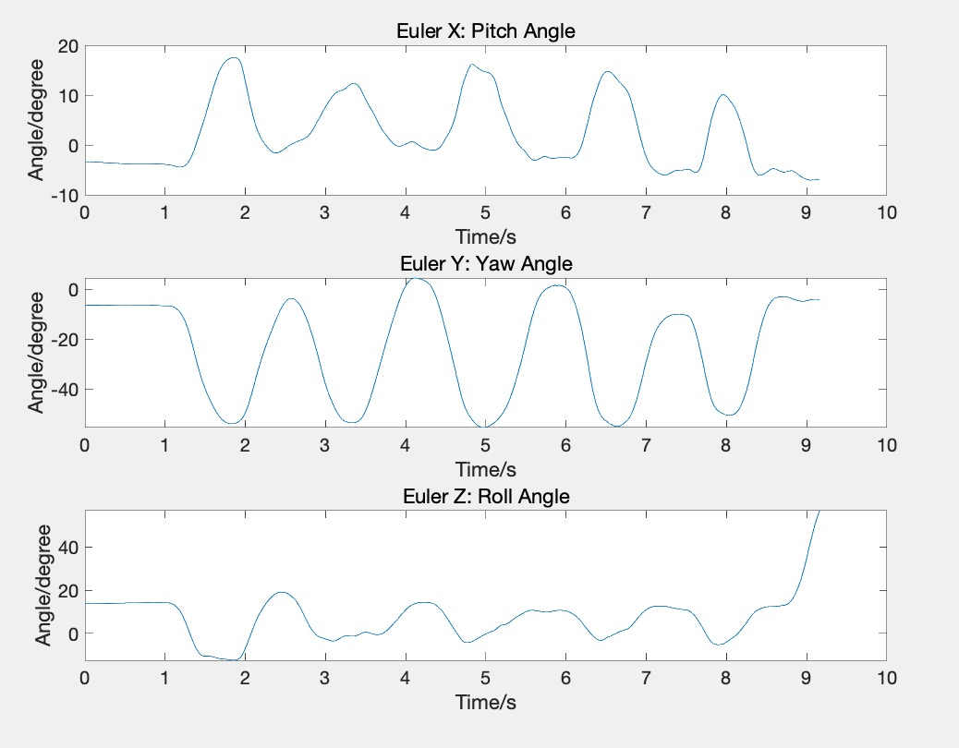
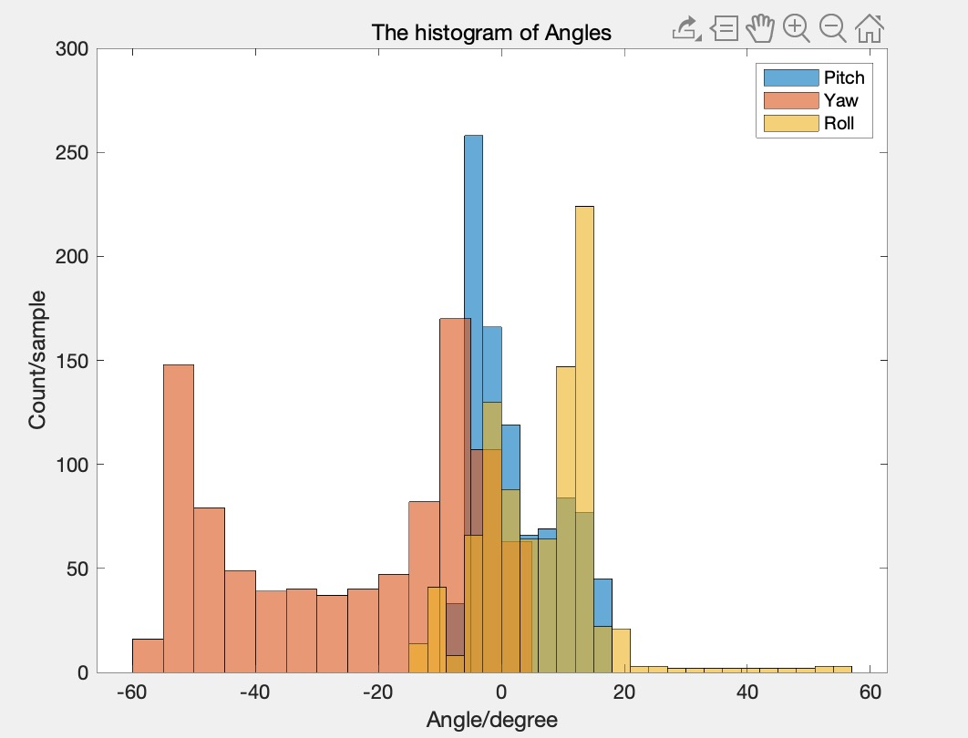
Mock OR Data Analysis – turn to left & right
Turn to left
Yaw angle changes between -10 degree to 45 degree periodically.
Turn to right
Yaw angle changes between -60 degree to 5 degree periodically.
Pitch angle and Roll angle change little and there is no significant difference between left and right circumstances.
Coordinate system figure from: https://stanford.edu/class/ee267/lectures/lecture10.pdf

Slide 26
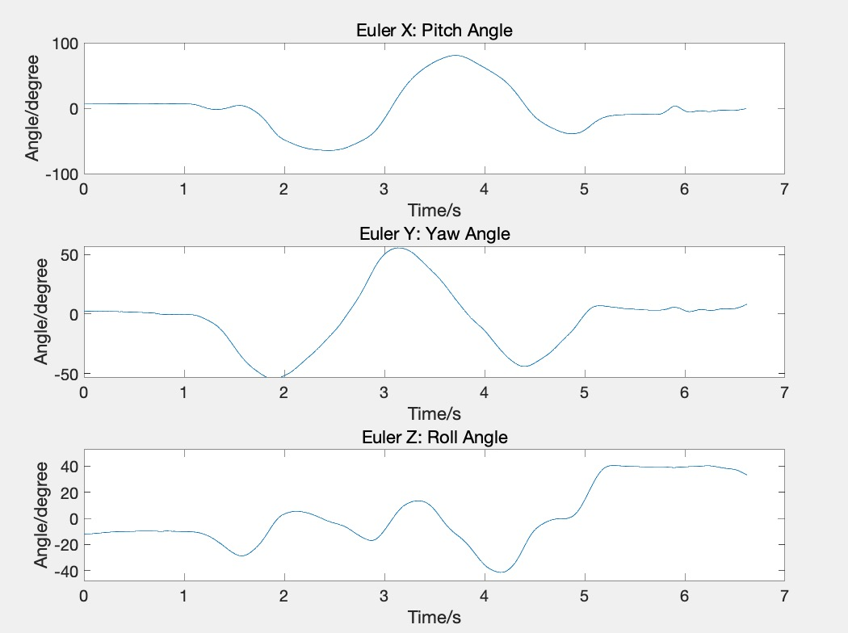
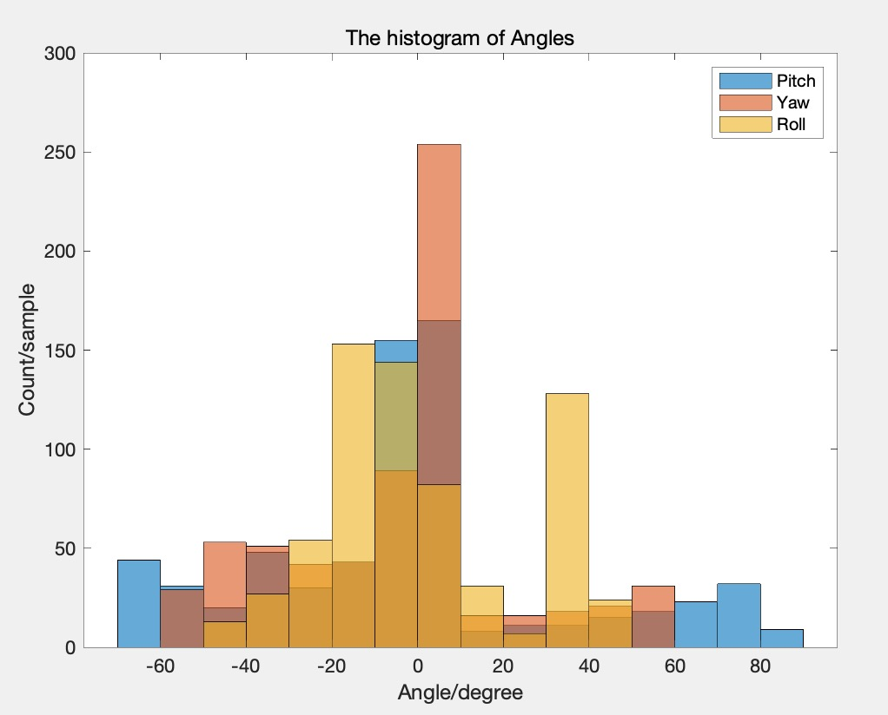
Mock OR Data Analysis – rotate circle
Pitch angle and Yaw angle change in a circle.
Roll angle changes randomly.
Coordinate system figure from: https://stanford.edu/class/ee267/lectures/lecture10.pdf

Slide 27
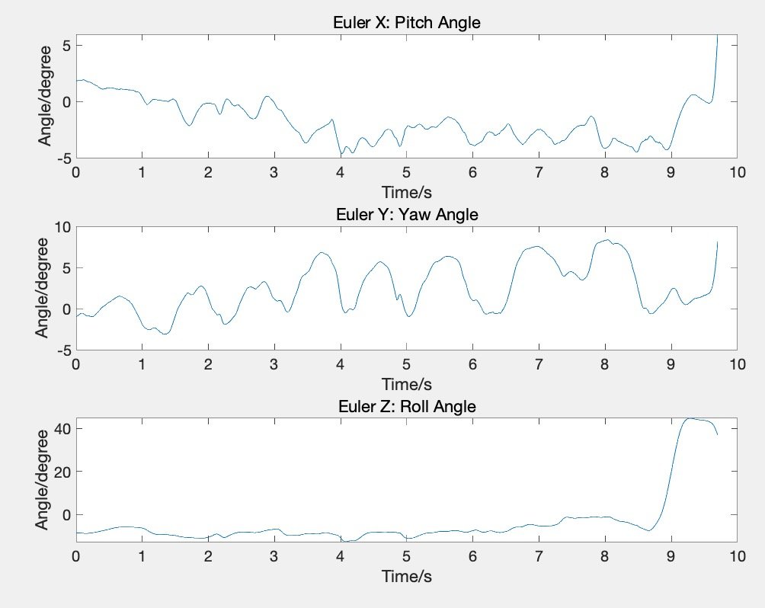
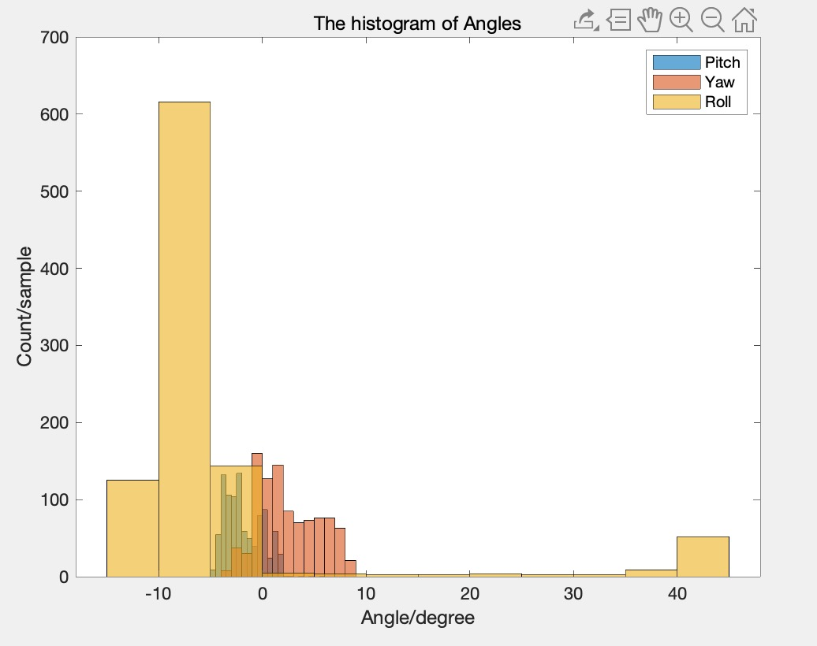
Mock OR Data Analysis – move shoulder
Pitch angle , Yaw angle, and Roll angle change little (almost zero degree).
Coordinate system figure from: https://stanford.edu/class/ee267/lectures/lecture10.pdf

Slide 28
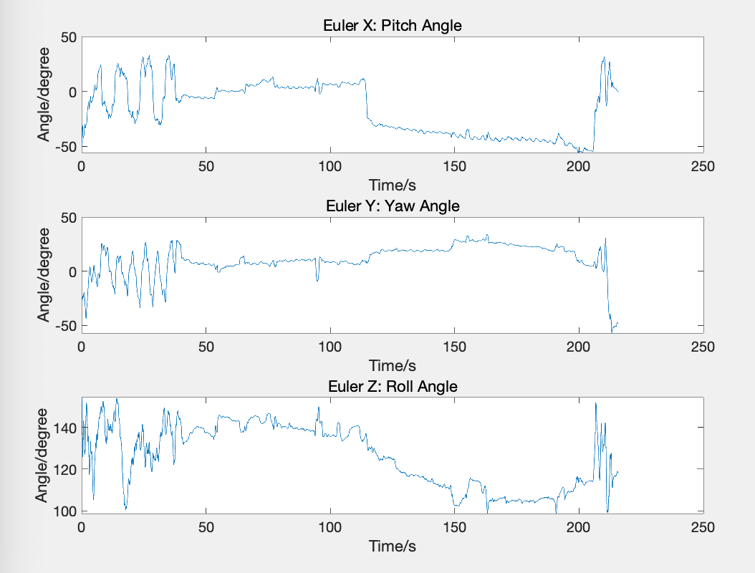
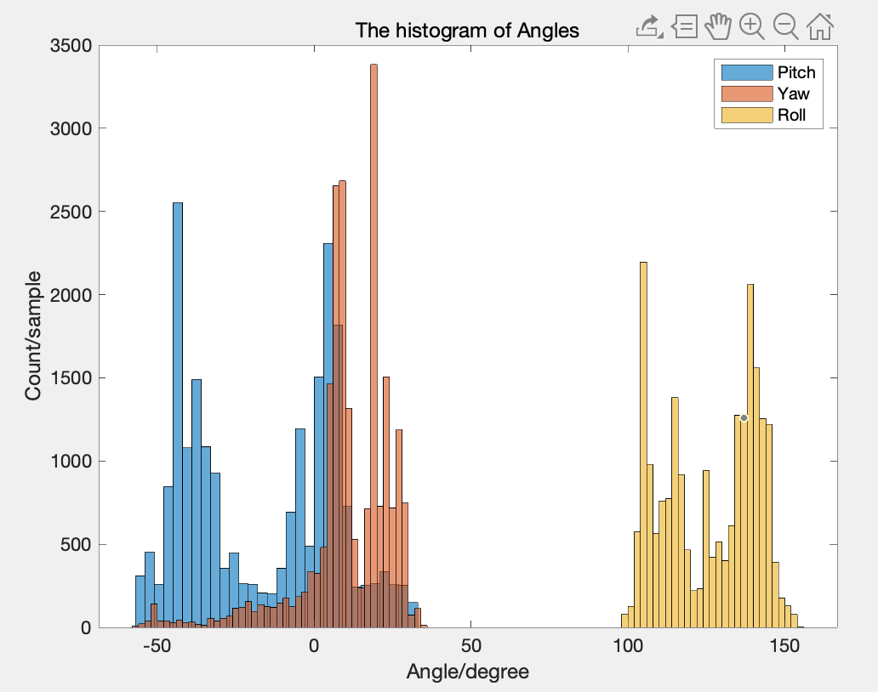
Ergonomics Position Data Analysis – Procedure 2
Walking and typing with computer in hands
Pitch Angle changes in (-50,30) degree.
Roll Angle changes in (100,150) degree.
Yaw Angle concentrates in (0,30) degree.
Coordinate system figure from: https://stanford.edu/class/ee267/lectures/lecture10.pdf

Slide 29
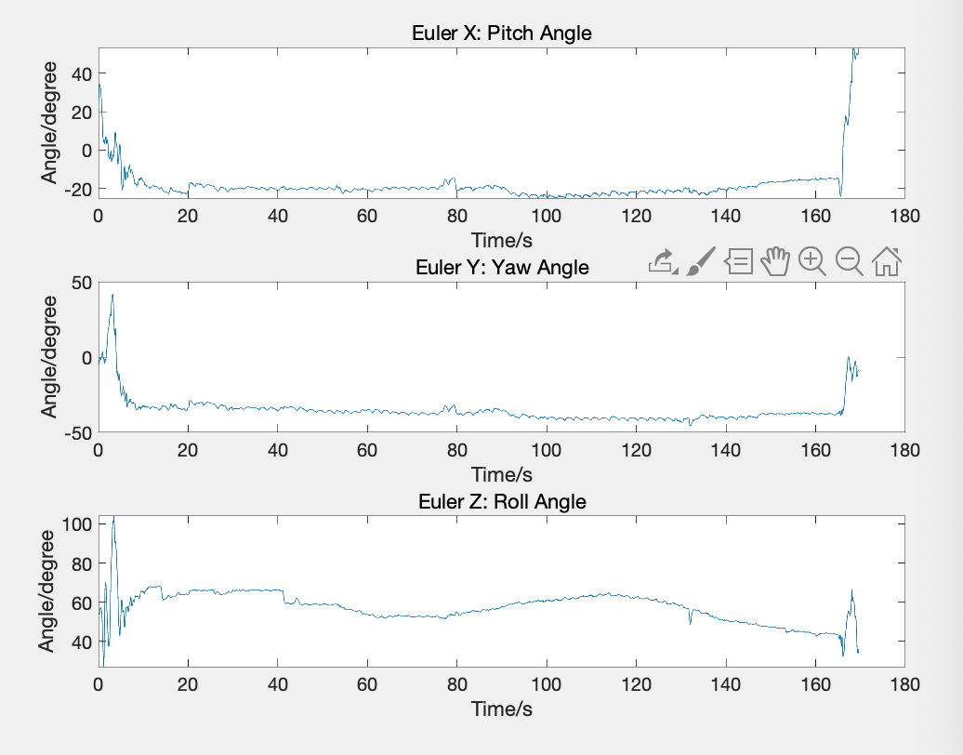
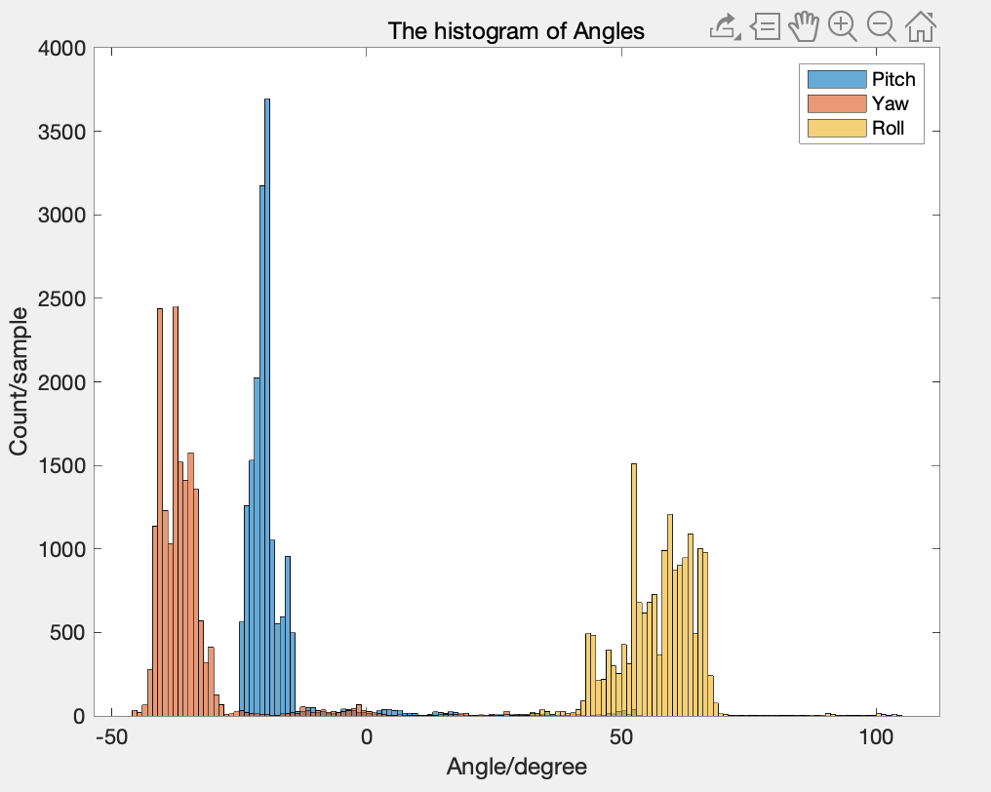
Ergonomics Position Data Analysis – Procedure 4
Slouching in bed, typing
• Pitch Angle almost concentrates on -20 degree.
• Yaw Angle almost concentrates on -40 degree.
• Roll Angle changes in the (40,65) degree.
Coordinate system figure from: https://stanford.edu/class/ee267/lectures/lecture10.pdf

Slide 30
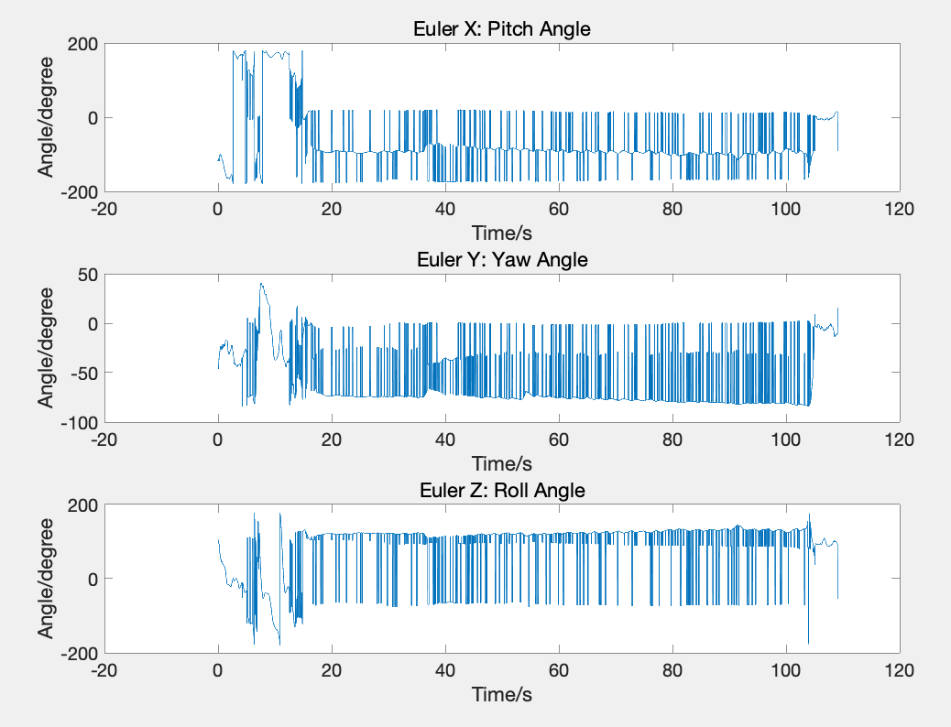
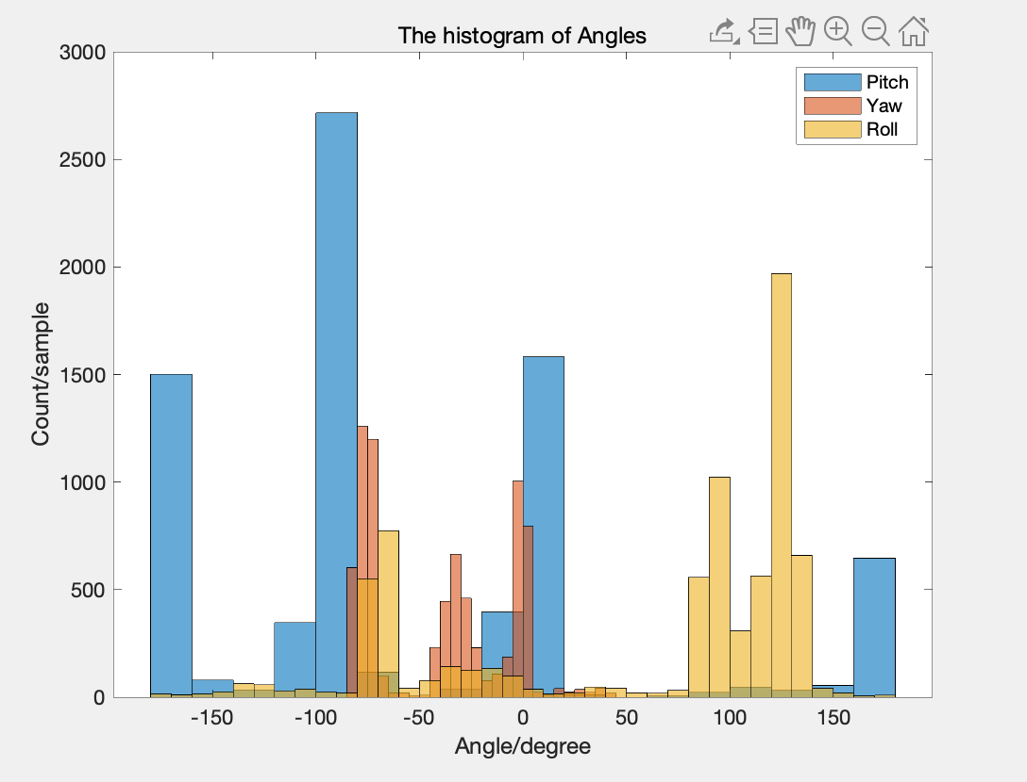
Ergonomics Position Data Analysis – Procedure 3 (?)
Coordinate system figure from: https://stanford.edu/class/ee267/lectures/lecture10.pdf

